Slide 1
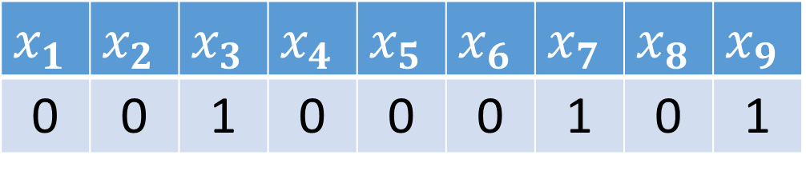
Feature Representation
“broke his foot”
$$x_{1}$$ | $$x_{2}$$ | $$x_{3}$$ | $$x_{4}$$ | $$x_{5}$$ | $$x_{6}$$ | $$x_{7}$$ | $$x_{8}$$ | $$x_{9}$$
0 | 0 | 1 | 0 | 0 | 0 | 1 | 0 | 1

Slide 2
Download msha_nature.csv at https://github.com/ameasure/autocoding-class
Randomly split this file into training, validation, and test datasets with 21035, 10000, and 10000 rows
Build the best nature autocoder using just your training and validation data
Calculate the accuracy of your best autocoder on your test data
Generate an Excel report for the test data which only contains autocodes where the autocoder is 80% confident or higher

Slide 3
Logistic Function

Slide 4
Multinomial Logistic Regression

Slide 5
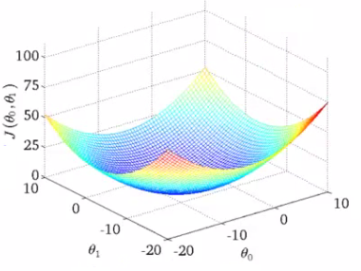


Gradient Descent
Cost(w)
$$w_{A1}$$
$$w_{A2}$$

Slide 6
Cost Function Revised

